Slide 1

Kriging with Iterative Spatial Prediction of Uncertainty KRISP-U
Matthew Burnett
Department of Mechanical Engineering
University of South Carolina

Slide 2
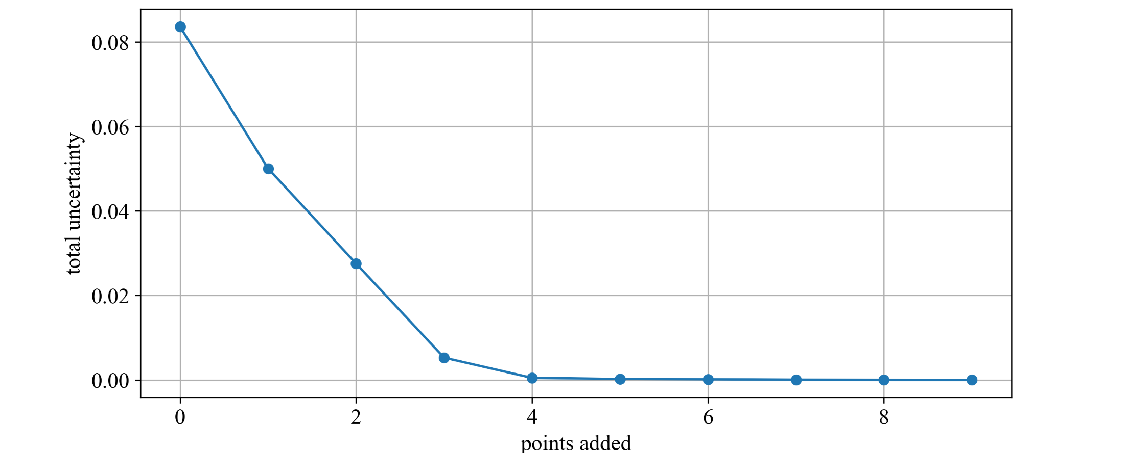
Motivation
Reduce the number of data points needed to characterize experimental domains
Specifically, in cases where sampling is expensive or otherwise arduous

Slide 3
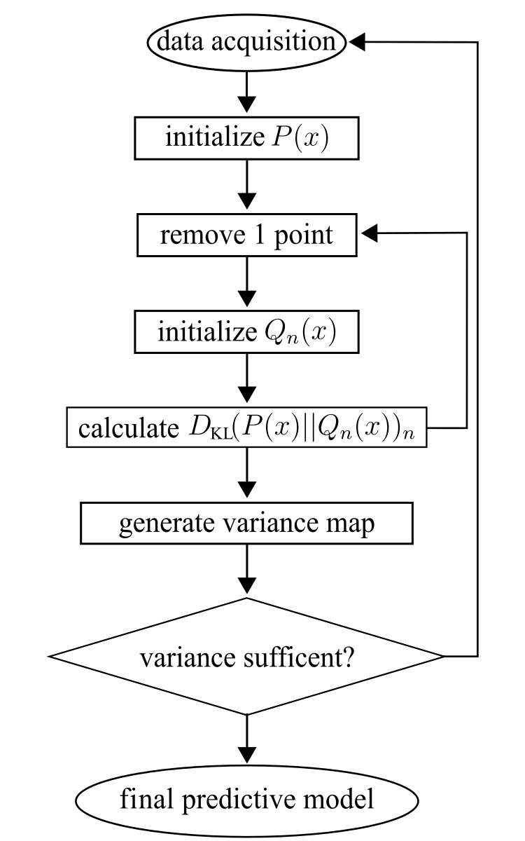
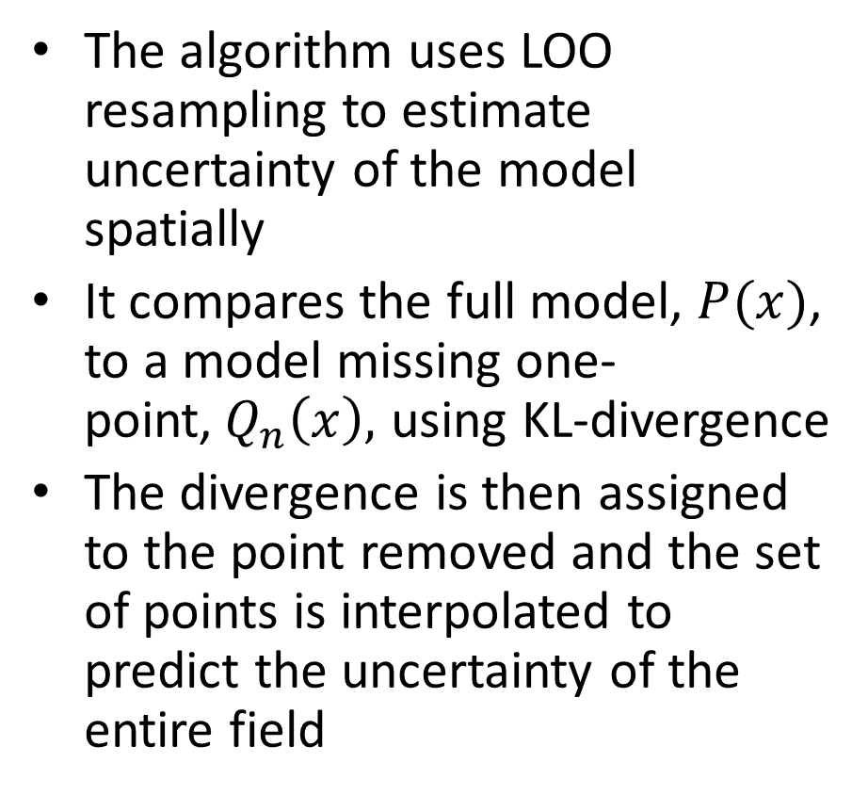
Algorithm
The algorithm uses LOO resampling to estimate uncertainty of the model spatially
It compares the full model, $P(x)$, to a model missing one-point,${ Q}_{n}\left(x\right),$ using KL-divergence
The divergence is then assigned to the point removed and the set of points is interpolated to predict the uncertainty of the entire field

Slide 4
KRISP-U
fit():
Fits the kriging model to the dataset and predicts over a grid.
evaluate():
Evaluates the model using cross-validation and computes uncertainties.
interpolate_uncertainty()
Interpolates uncertainties over a spatial grid.
print_stats()
Prints statistics of the fitted model.
get_stats()
Analyzes the variogram of the fitted model.

Slide 5
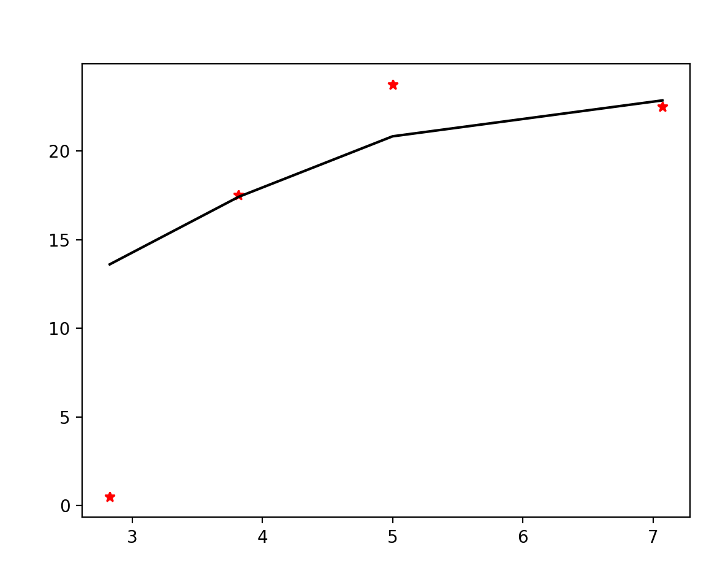
Model Selection
Proper variogram selection is essential the model will be meaningless otherwise
If enable_plotting is True the variogram will be plotted for you
Scikit has a great tutorial on variogram selection
Any variogram in the PyKrige library can be used
Universal or Ordinary Kriging can be selected
The difference is Ordinary kriging assumes a constant mean while Universal Kriging assumes the mean drifts

Slide 6
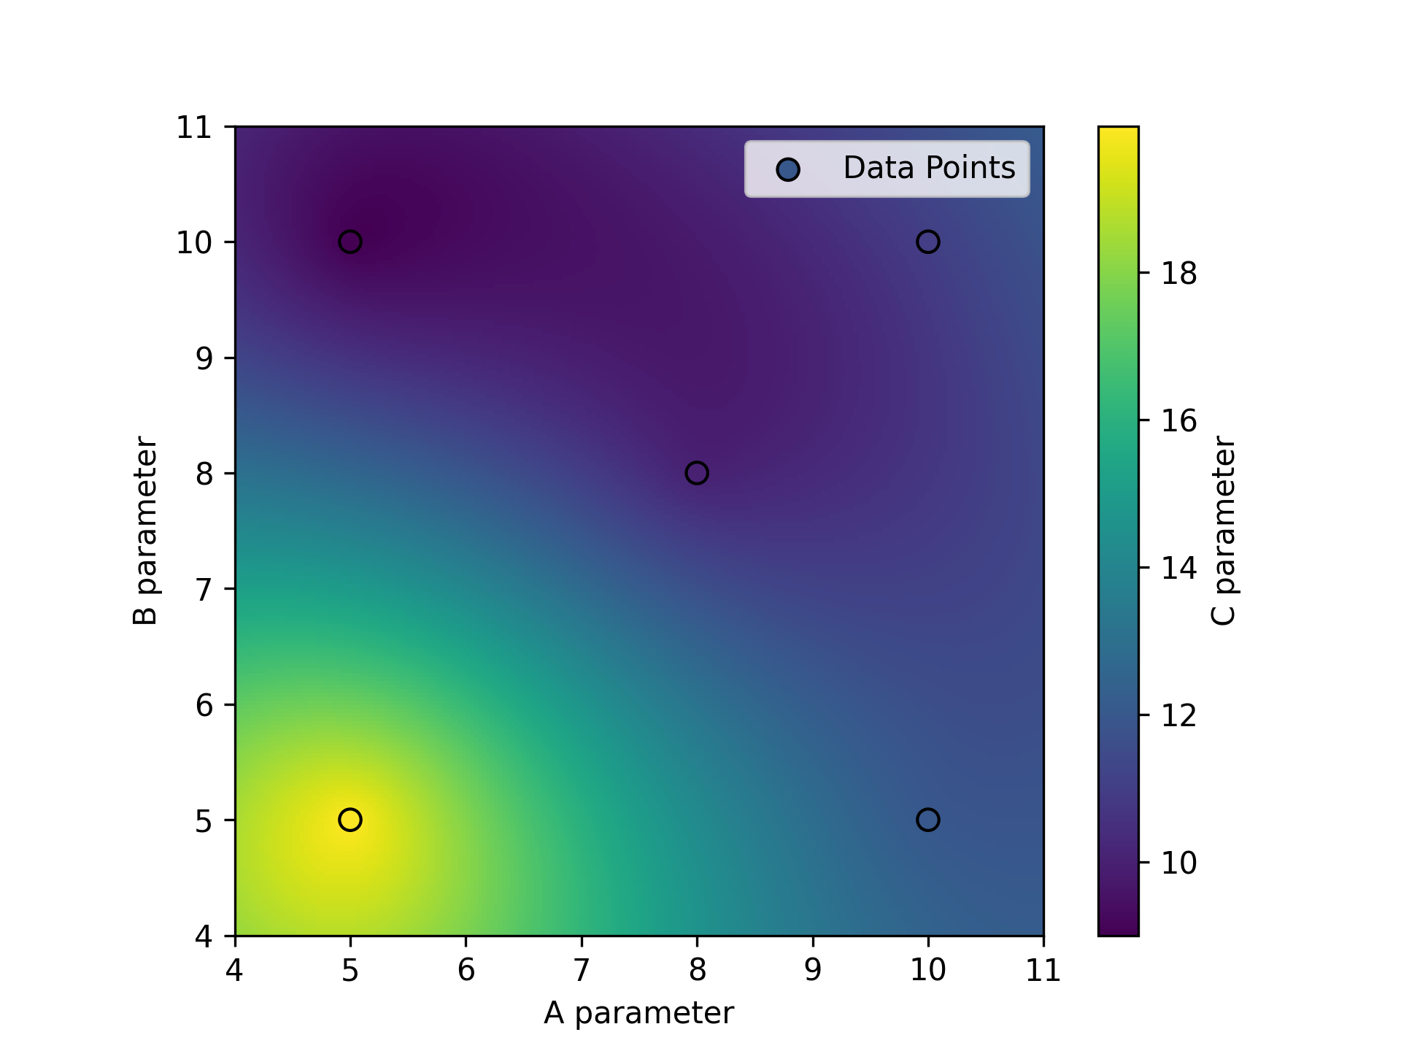
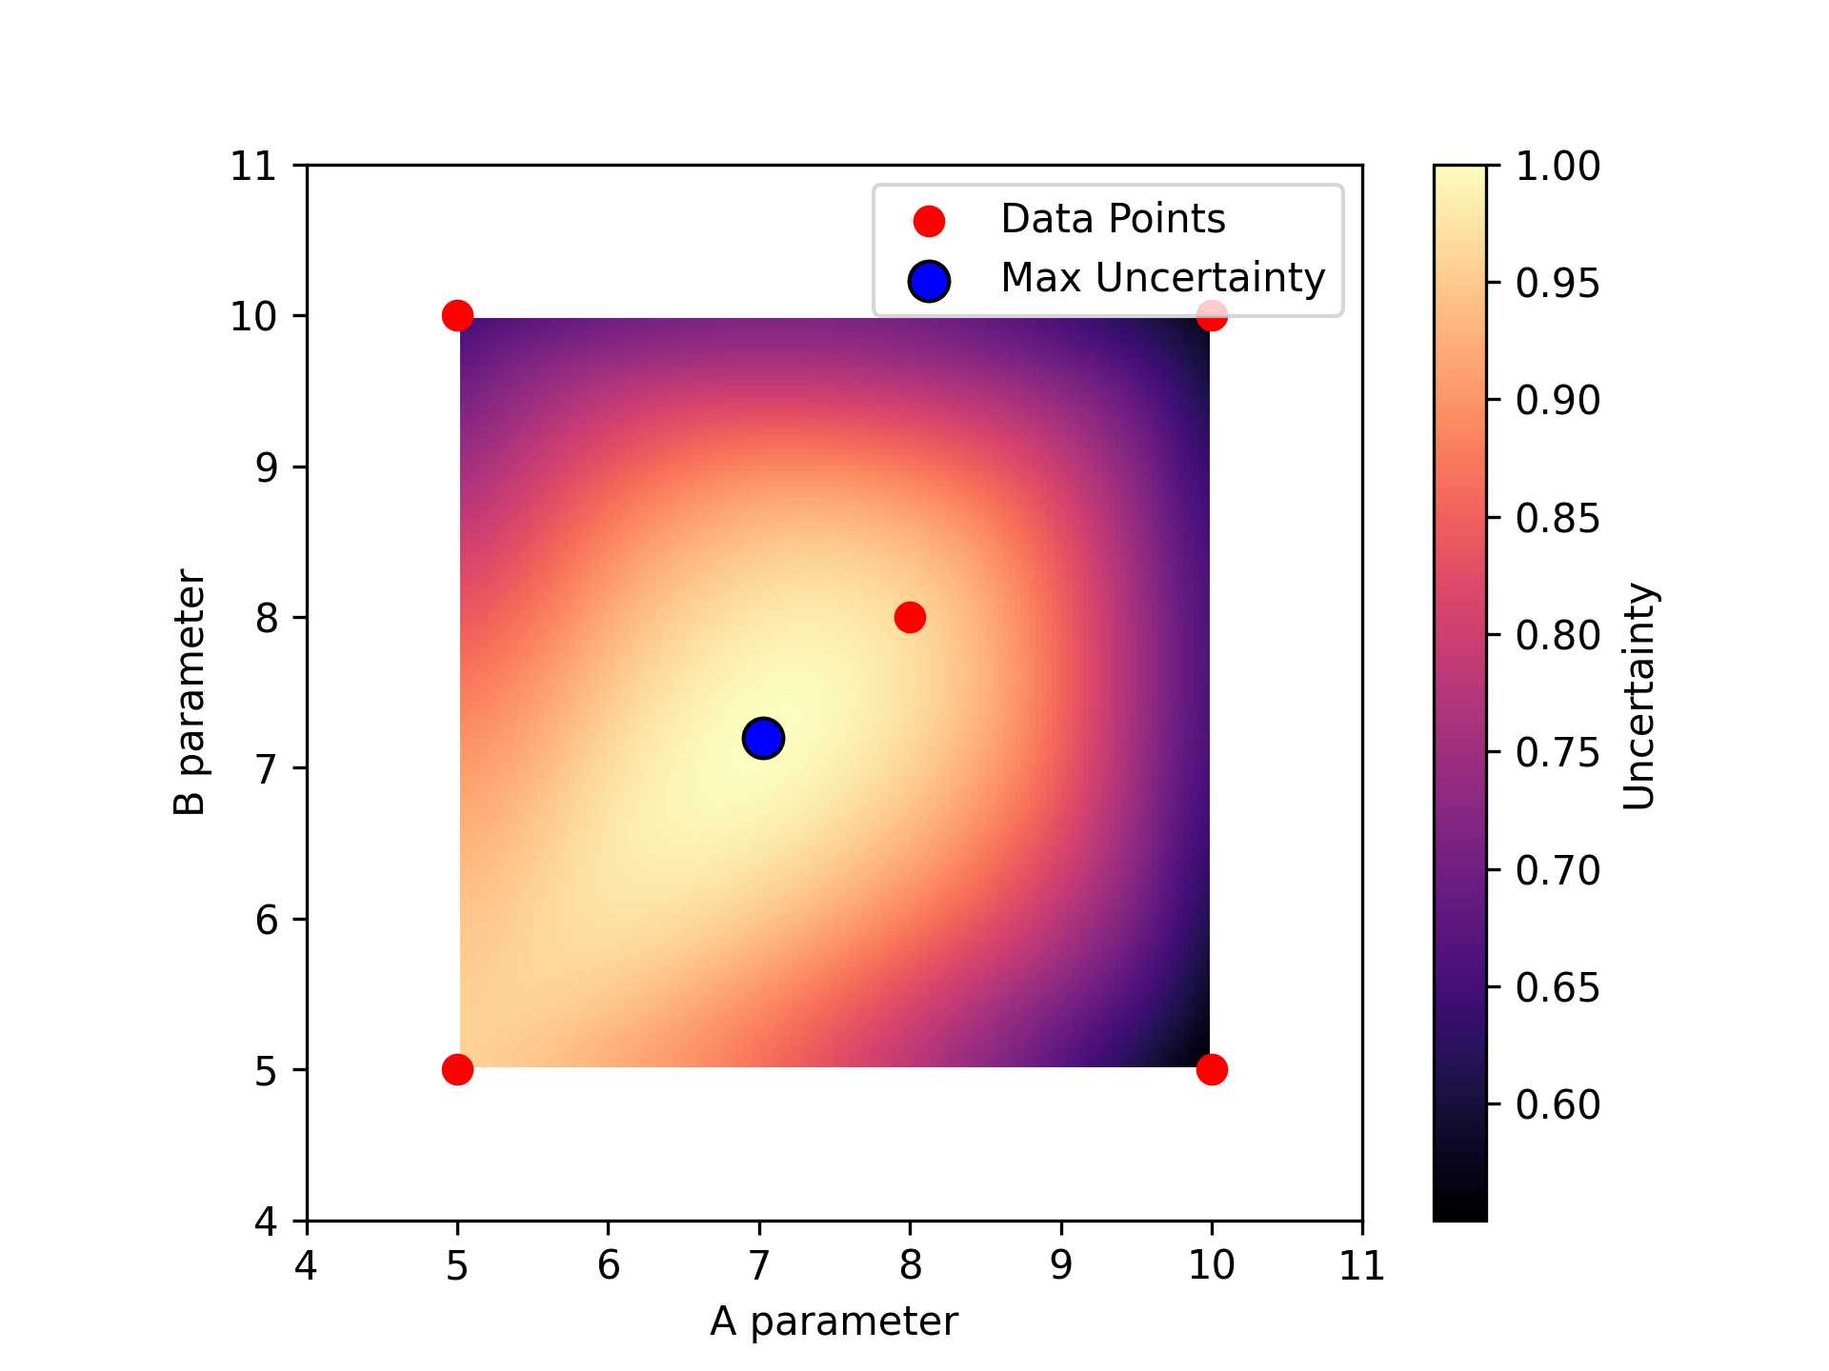
Fitting and Evaluation
The model both predicts the expected values and the error spatially, additionally it recommends the optimal testing location (where uncertainty is maximum)

Slide 7
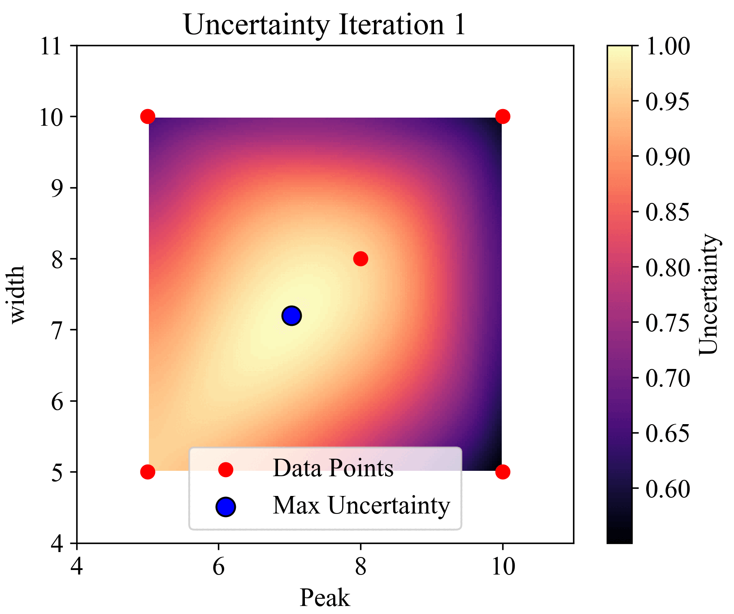
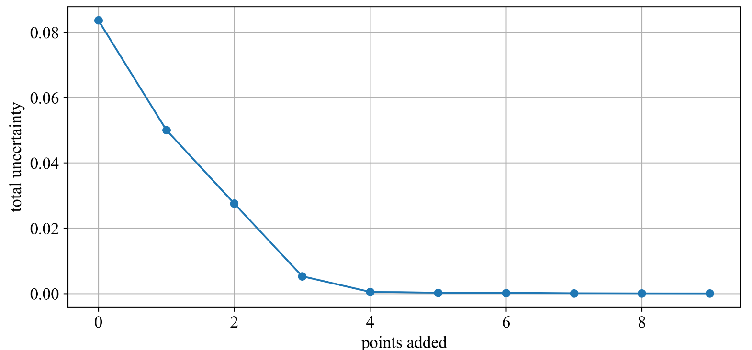
Simulated Iterative Sampling
Has tendency to resample locations
Effectively reduces total uncertainty in simulated cases

